Slide 1
The Transcriptomic Signatures of Plant Memory
Austin Rosén
Colorado State University
Department of Biology

Slide 2
Project Review
What?: Perform RNA-seq analysis on publicly available raw data from a previous study, and attempt to achieve the same results
Why?: In order to gain proficiency in working with high-throughput sequence data
Prepare me for future data analysis
I have yet to work through an entire pipeline – raw data to data analysis
Great learning opportunity because can check/compare results

Slide 3
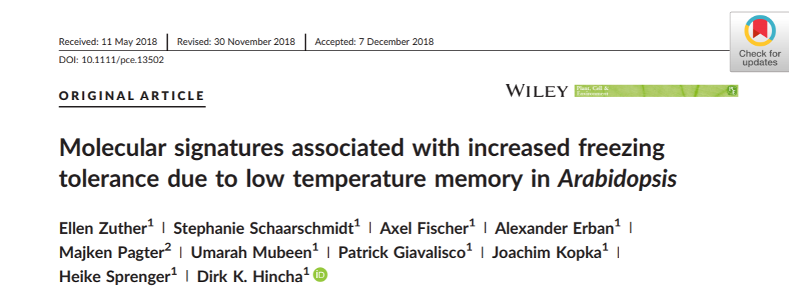
Study
Topic: The concept of plant memory associated with stress, and the associated molecular signatures

Slide 4
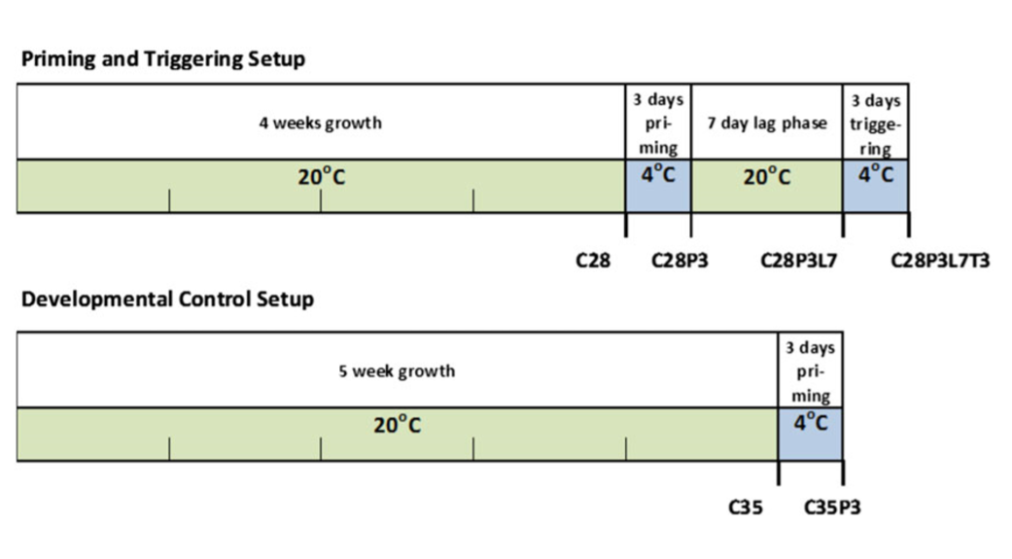
Study Design
The experiment was originally performed for two A. thaliana varieties
6 measurements in each trial x 3 replicates x 2 Arabidopsis accessions = 36 samples
I decided to look at just one variety
Col-0 (intermediate frost tolerance) – 18 total samples
Col-0 (3 reps)
N14 (3 reps)

Slide 5
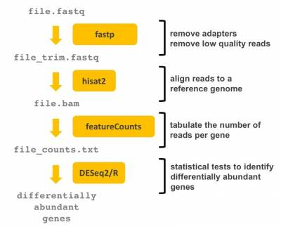
Pipeline comparisons
Zuther et al., 2018
Pipeline that I used
flexbar
STAR
STAR
DESeq2/R

Slide 6
Methods given in paper
Adapter trimming – flexbar version 2.5
Reads less than 80 bp in length were removed
Reference genome - A. thaliana accession Col‐0
Genomic fasta sequence and GTF annotation files were downloaded from Ensembl Plants, Version TAIR10, Release 31
Read mapping and tabulation - STAR Version 2.5.2a
‐‐outSAMtype BAM SortedByCoordinate
‐‐outFilterMultimapNmax 20
‐‐alignSJDBoverhangMin 8
‐‐outSAMunmapped Within
‐‐quantMode TranscriptomeSAM GeneCounts

Slide 7
Methods given in paper
Differential Gene Expression (DGE) Analysis – DESeq2 in R
R Version 3.4.2 and RStudio Version 1.1.383
lowly expressed genes less than five counts per gene for all samples were removed
parameter fitType was set to “local”
false discovery rate < 0.1 and absolute log₂FC of >1
Principle Components Analysis (PCA) – DESeq2 and ggplot2
Count data was first regularized via log transformation (rlog)

Slide 8
Results comparison
32,833 genes identified after alignment and tabulation
Original paper had 33,602
Genes with less than 5 reads were removed leaving 23,386 genes for DGE analysis
Original paper had 24,574 genes

Slide 9
Results comparison
Green = Results of the original study
Black = My results before averaging the 3 reps
Comparison | Detail | Up |  | Down |  | Total
A | C35/C28 | 61 | 32 | 14 | 1 | 75 | 33
B | C28P3/C28 | 2486 | 794 | 2913 | 1220 | 5399 | 2014
C | C35P3/C28 | 2102 | 618 | 2318 | 817 | 4420 | 1435
D | C35P3/C35 | 2373 | 706 | 2614 | 1022 | 4987 | 1728
E | C35P3/C28P3 | 62 | 30 | 4 | 1 | 66 | 31
F | C28P3L7/C28 | 116 | 27 | 12 | 1 | 128 | 28
G | C28P3L7/C35 | 1 | 2 | 0 | 1 | 1 | 3
H | C28P3L7T3/C28 | 1763 | 520 | 1950 | 591 | 3713 | 1111
I | C28P3L7T3/C28P3 | 235 | 68 | 15 | 2 | 250 | 70
J | C28P3L7T3/C28P3L7 | 1361 | 264 | 1632 | 476 | 2993 | 740
K | C28P3L7T3/C35P3 | 2 | 1 | 0 | 0 | 2 | 1

Slide 10
Results comparison
Green = Results of the original study
Black = My results after averaging the 3 reps
Comparison | Detail | Up |  | Down |  | Total
A | C35/C28 | 20 | 32 | 5 | 1 | 25 | 33
B | C28P3/C28 | 829 | 794 | 971 | 1220 | 1800 | 2014
C | C35P3/C28 | 701 | 618 | 773 | 817 | 1474 | 1435
D | C35P3/C35 | 791 | 706 | 871 | 1022 | 1662 | 1728
E | C35P3/C28P3 | 21 | 30 | 1 | 1 | 22 | 31
F | C28P3L7/C28 | 39 | 27 | 4 | 1 | 43 | 28
G | C28P3L7/C35 | 0 | 2 | 0 | 1 | 0 | 3
H | C28P3L7T3/C28 | 588 | 520 | 650 | 591 | 1238 | 1111
I | C28P3L7T3/C28P3 | 78 | 68 | 5 | 2 | 83 | 70
J | C28P3L7T3/C28P3L7 | 454 | 264 | 533 | 476 | 987 | 740
K | C28P3L7T3/C35P3 | 1 | 1 | 0 | 0 | 1 | 1

Slide 11
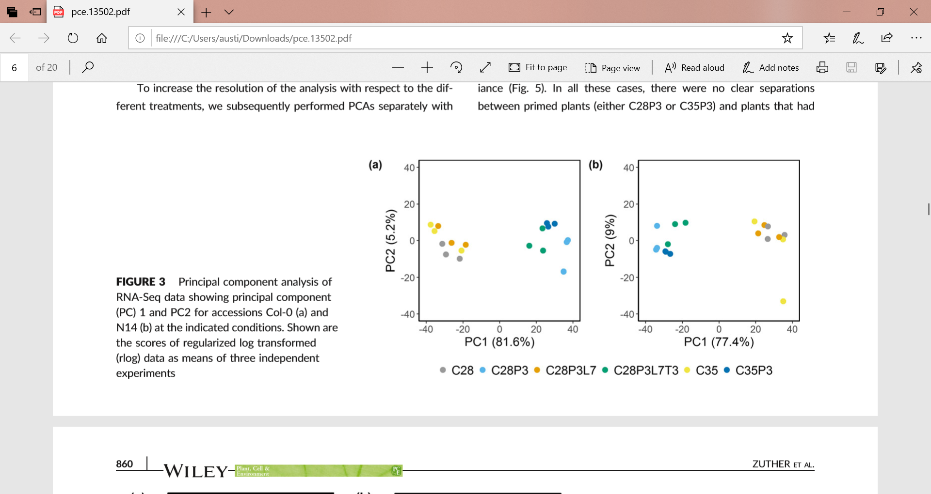
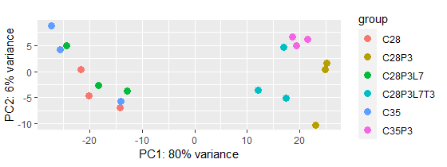
Results comparison
Original study
My results

Slide 12
Reasons for differences?
Differences in counts for up-regulated and down-regulated genes was greater than anticipated
Different programs were used, though options were mimicked
More recent version of the annotated genome
Overall, same general pattern was seen, especially in PCA

Slide 13
Lessons learned and comments
Downloading publicly available data is not extremely intuitive
Super easy once you’ve done it once – SRA toolkit
Downloaded directly into summit ~ 40 GB
Scratch space on summit give you 10TB of storage
Used summit for everything but DGE and PCA
Didn’t have to store massive files on my own computer
Download fastp, hisat2 and subread (contains featureCounts) directly into summit
Wrote single script that performed trimming, alignment, and tabulation for just single sample, then expanded to all samples
Took about an hour to run on summit for all 18 samples

Slide 14
Lessons learned and comments
Using DESeq2 – super easy
Data manipulation to get data in correct format for analysis was hardest part
Extremely easy to do the PCA
### Transform counts for data visualization
rld <- rlog(dds, blind=TRUE)
### Perform and Plot PCA
plotPCA(rld, intgroup="treatment")
PCA results nearly identical to original study

Slide 15
Next Steps
Incorporate the other Arabidopsis accession into the analysis – 18 more samples
Compare differences in up-regulated and down-regulated gene counts to see if differences are statistically significant or not
Redo analysis using same programs and options as original study – are results truly identical?
Perform functional enrichment analysis and compare to original study

